Slide 1
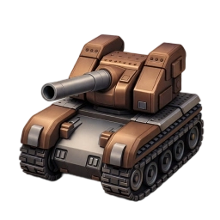
Tank Maze Game
Author: Xinyu Jiang, Yang Tian

Slide 2
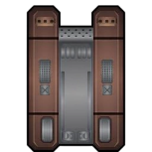

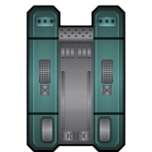

Game Modes
Basic Controls
Single Player Mode
Features
Target: Reach the exit.
Obstacles: AI NPC’s attack.
You have to survive it.
Innovations
Cooperation
Statements

Slide 3
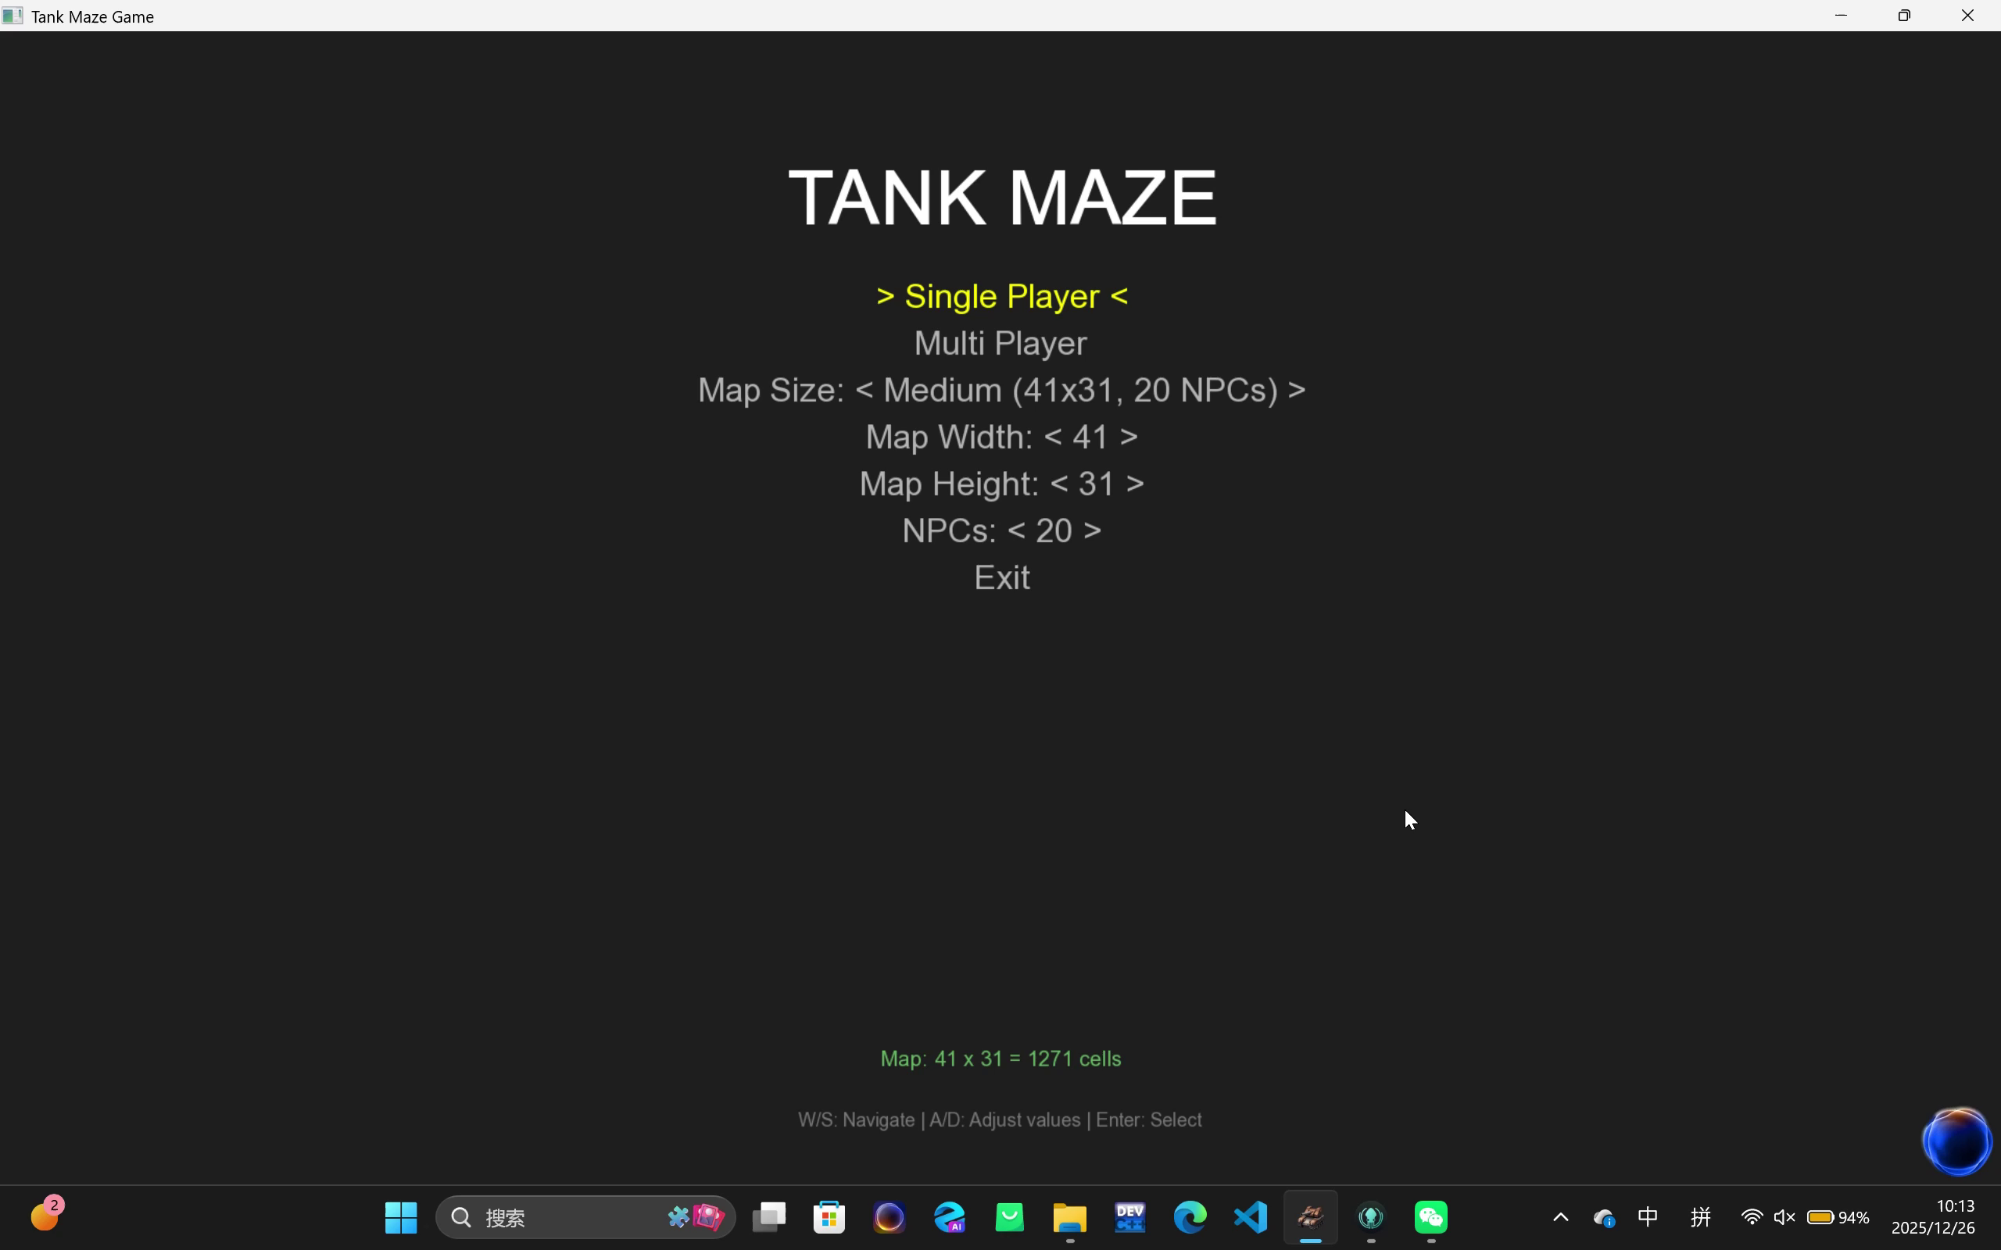
Game Modes
Basic Controls
Features
Innovations
Cooperation
Statements

Slide 4
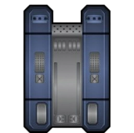

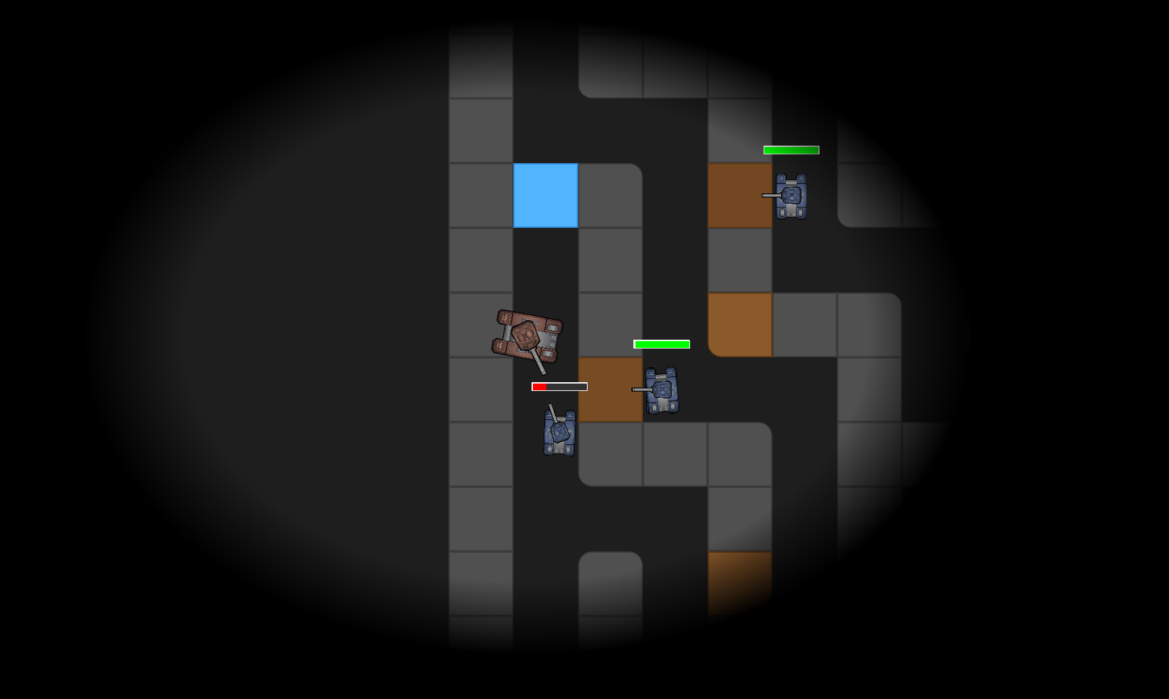
Game Modes
Escape Mode
Battle Mode
Basic Controls
Two players are cooperators.
Target: Both reach the exit
Obstacles: AI NPC’s attack.
Two players are components.
Target: First to reach the exit or defeat another player.
Obstacles: Attacks from
the other player and his ally NPCs.
Features
Innovations
Cooperation
Statements
Additional option: Dark Mode
(restrict both players’ vision to an ellipse).

Slide 5
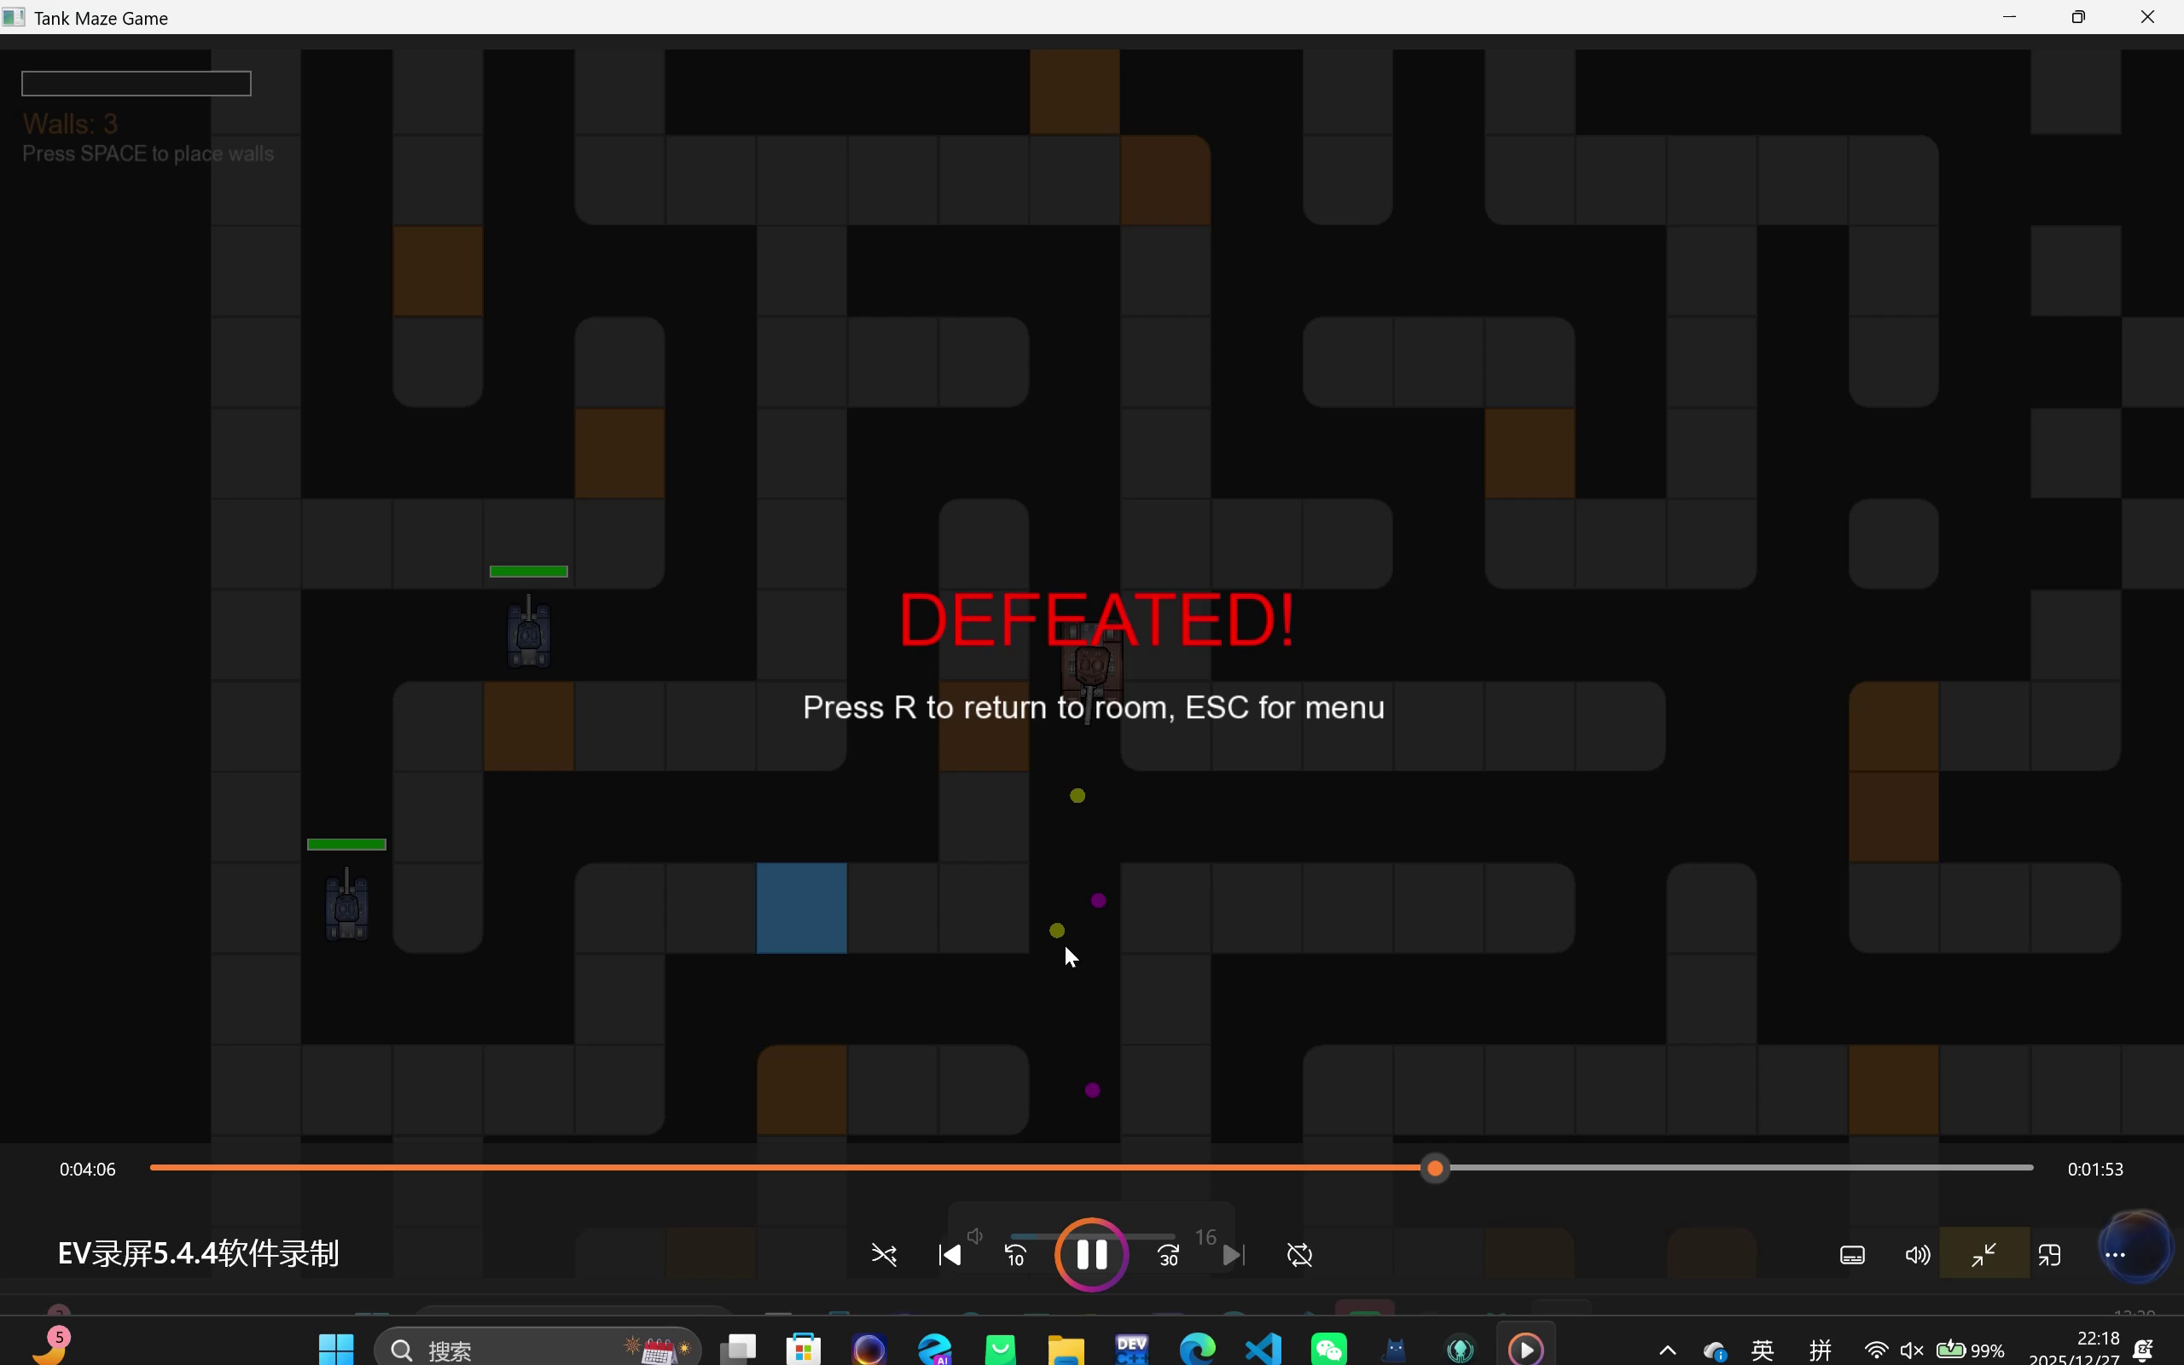
Game Modes
Basic Controls
Features
Innovations
Cooperation
Statements

Slide 6
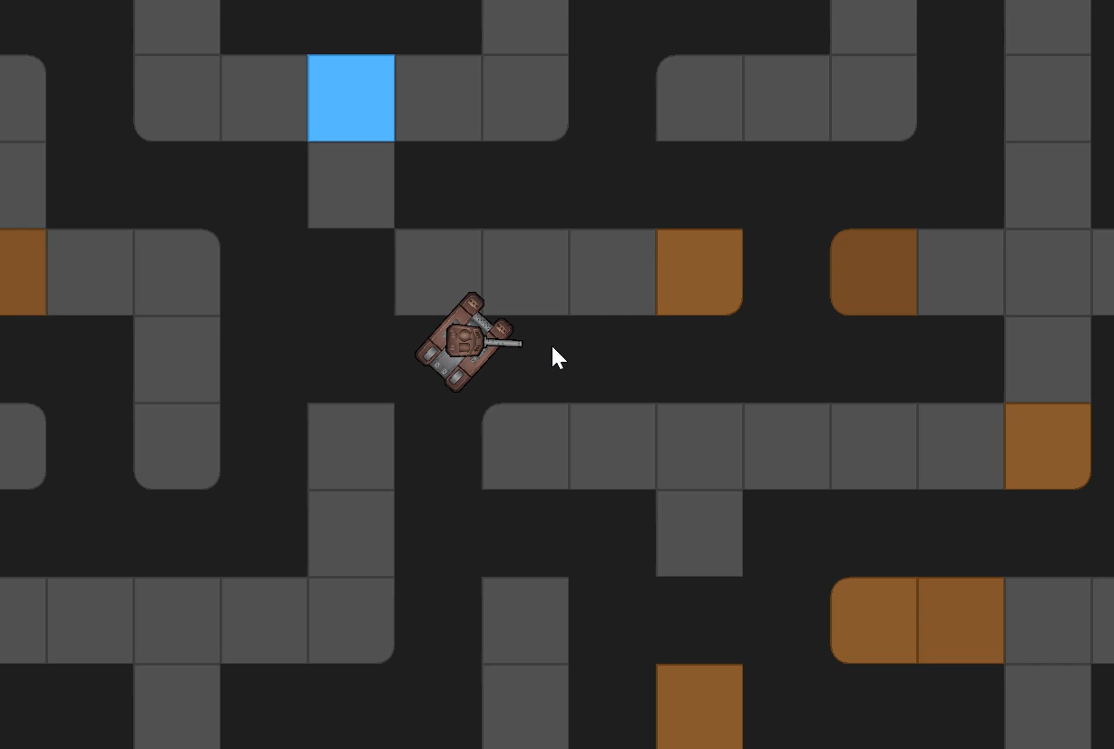
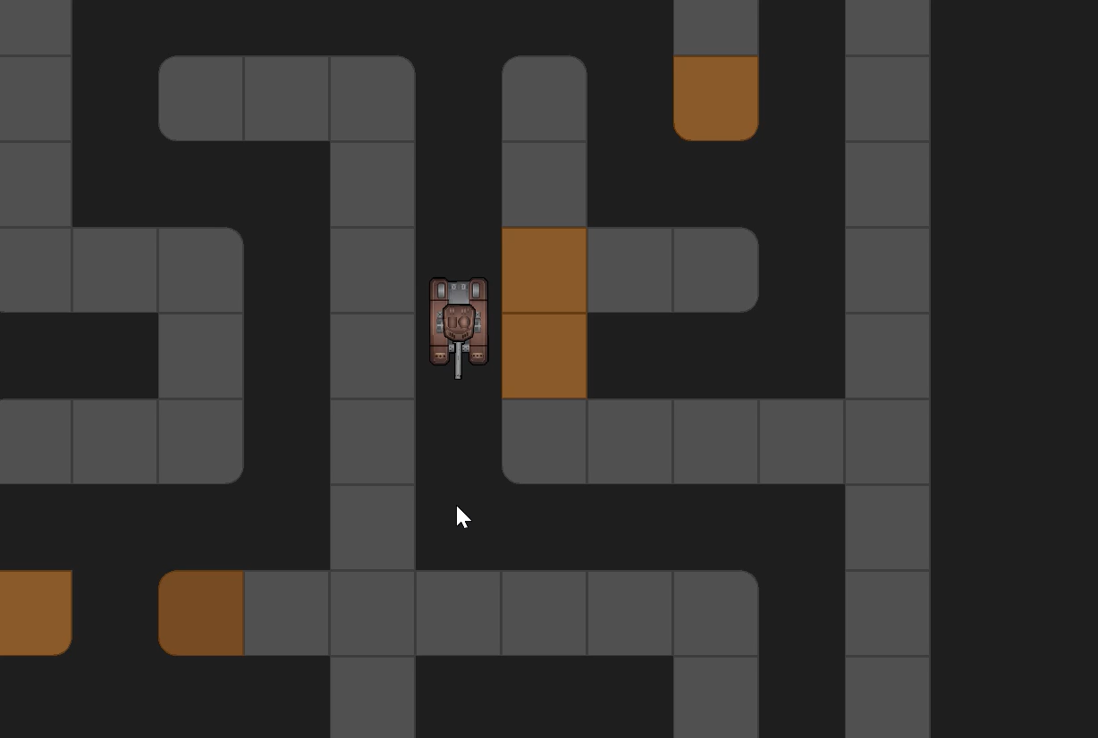
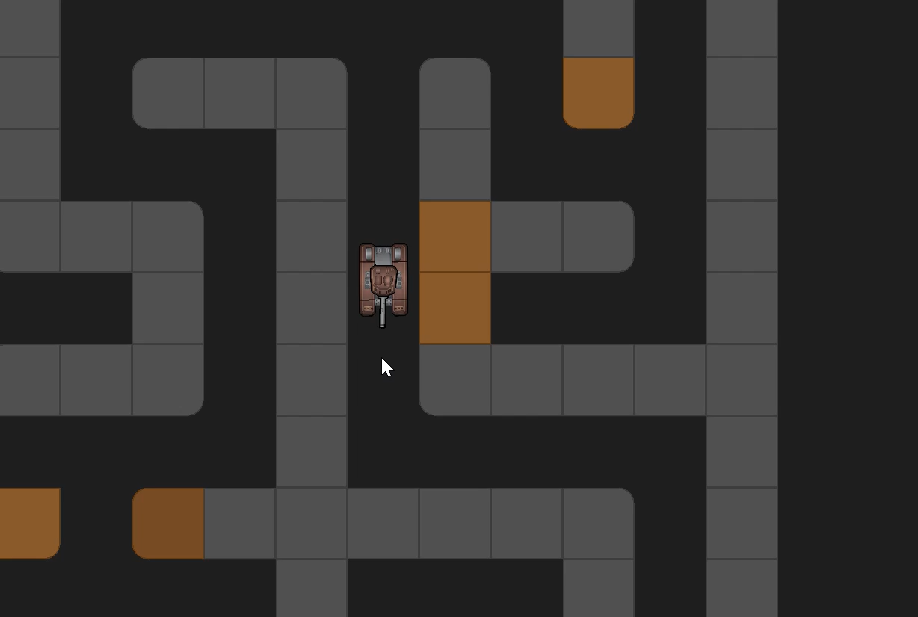
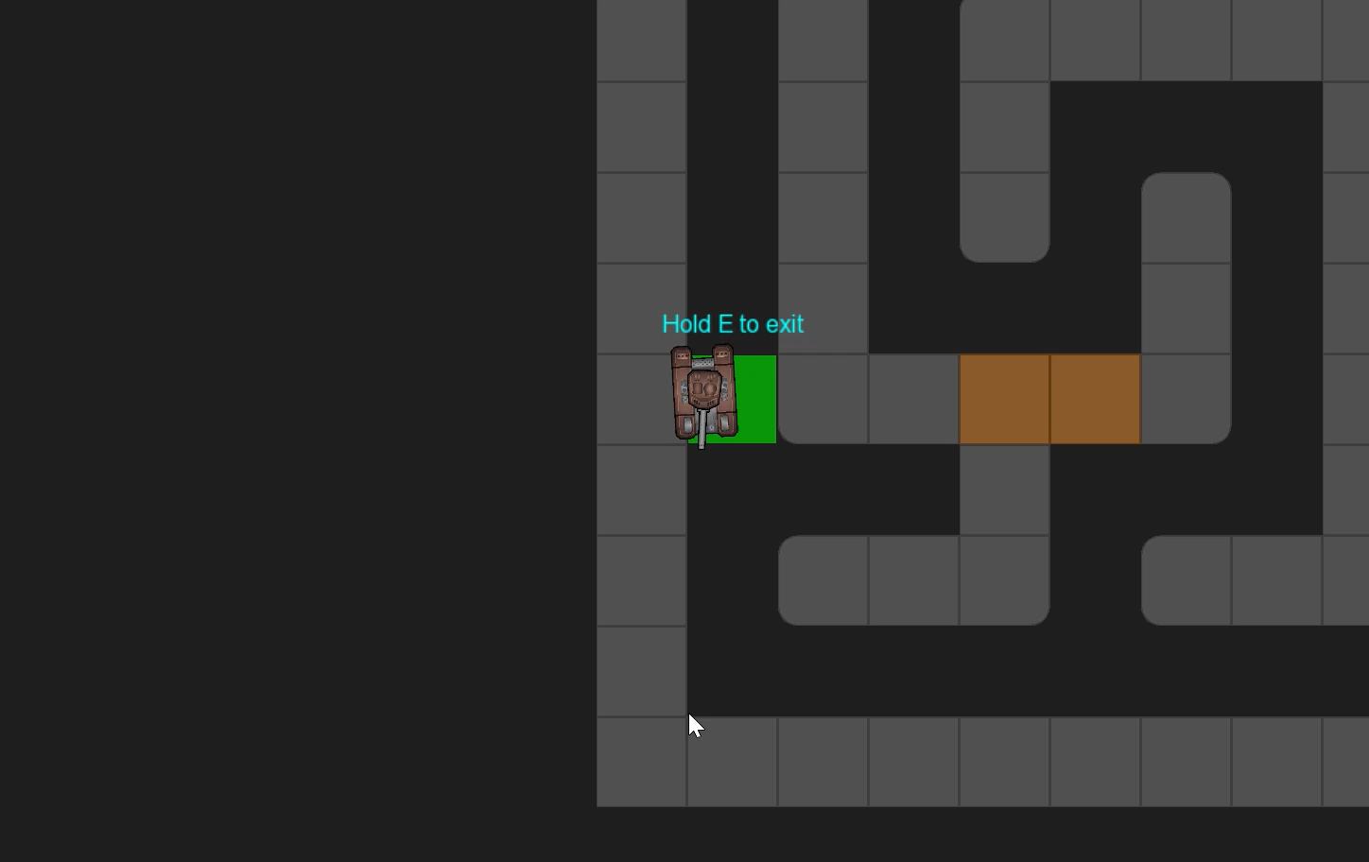
Game Modes
Press WASD
Control directions
Single left click
Fire bullet
Basic Controls
Features
Innovations
Mouse
Aim turret
Press E
Exit
Cooperation
Statements

Slide 7


Game Modes
Randomly Generated Maze- Every game features a unique randomly generated maze
Basic Controls
Online support: Based on a server, in mulit-player mode, two players can operate their tanks on different devices.
Features
Cross-Platform Support: The game supports both macOS system and Windows system
Innovations
Cooperation
Statements

Slide 8
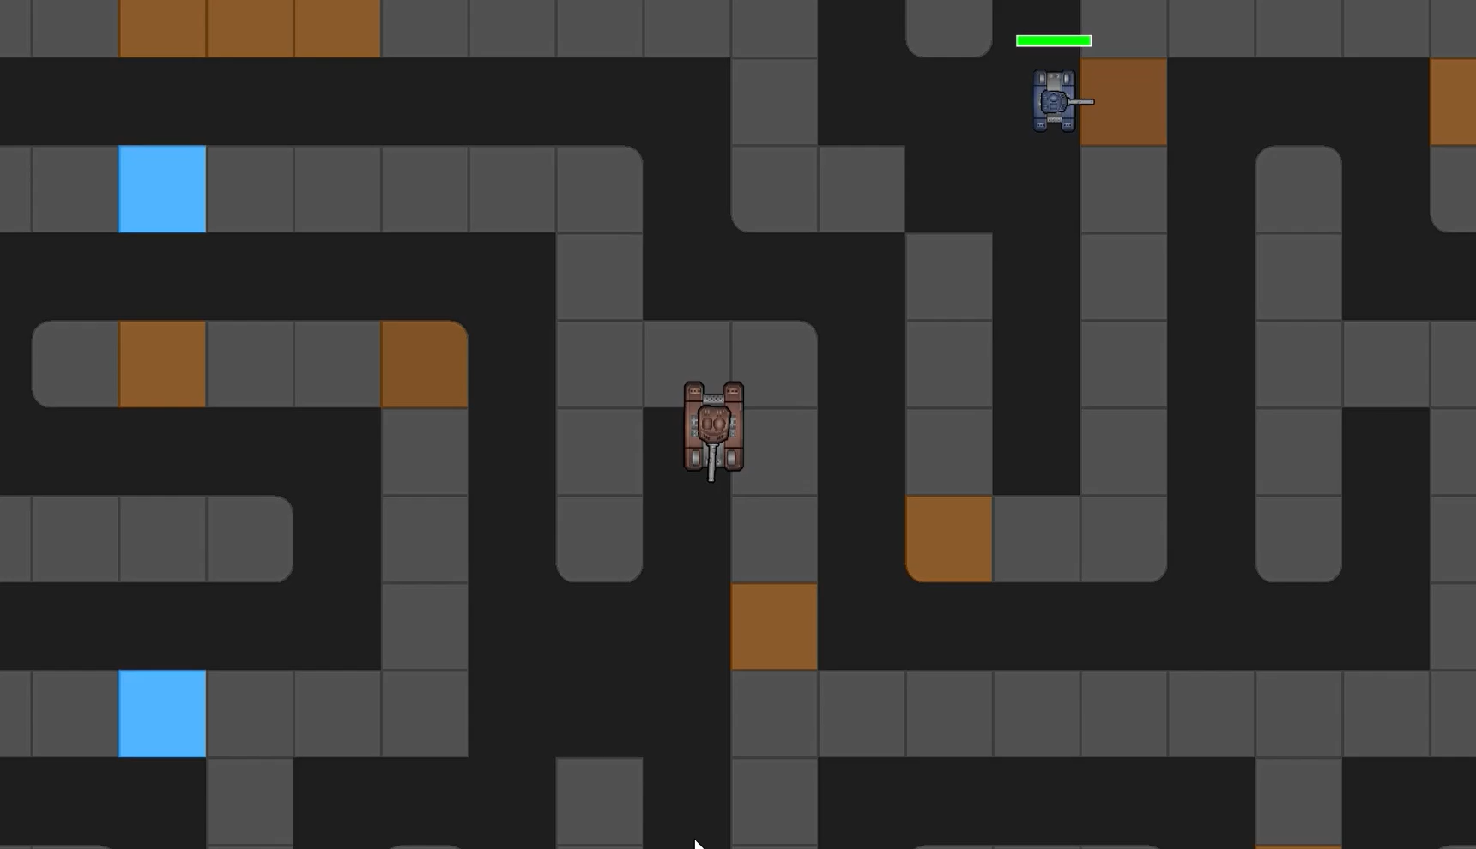
Smart AI NPCs - Enemies with pathfinding and strategic behavior
Game Modes
Basic Controls
Features
Innovations
Cooperation
Immersive Audio - Dynamic background music and spatial sound effects with 3D positioning. Sound effects attenuate based on distance from the camera
Fairness - The game uses a fixed logical resolution independent of the actual window size. Players see the same game area with identical zoom levels. Plus, none of the two maps generated are the same.
Statements

Slide 9
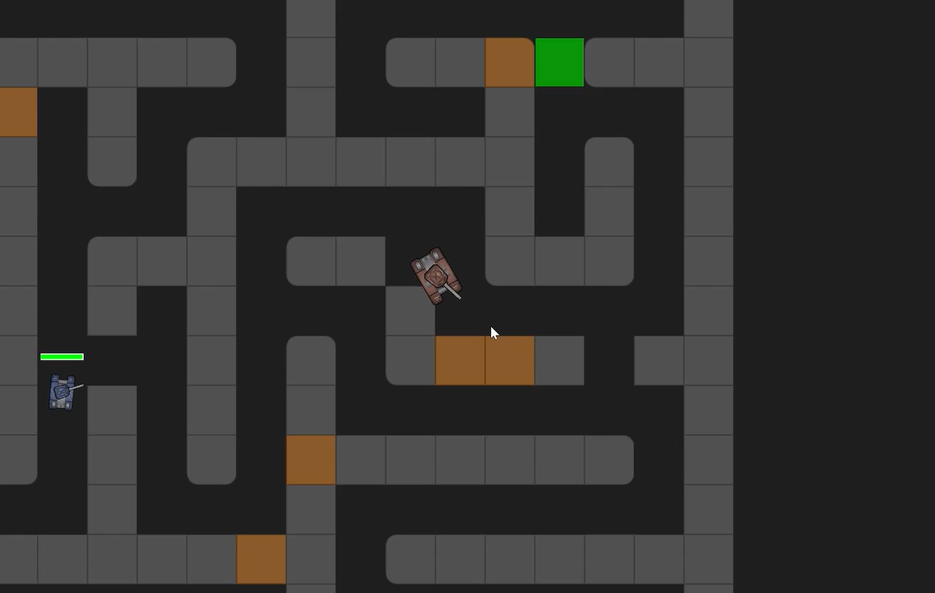
Special Wall Types - Destructible walls with unique effects (repositioning, healing, gold rewards)
Game Modes
Basic Controls
Brown walls: Collect it for future use.
Press Space to place the wall anywhere reasonable you like.
Features
Innovations
Cooperation
Statements

Slide 10
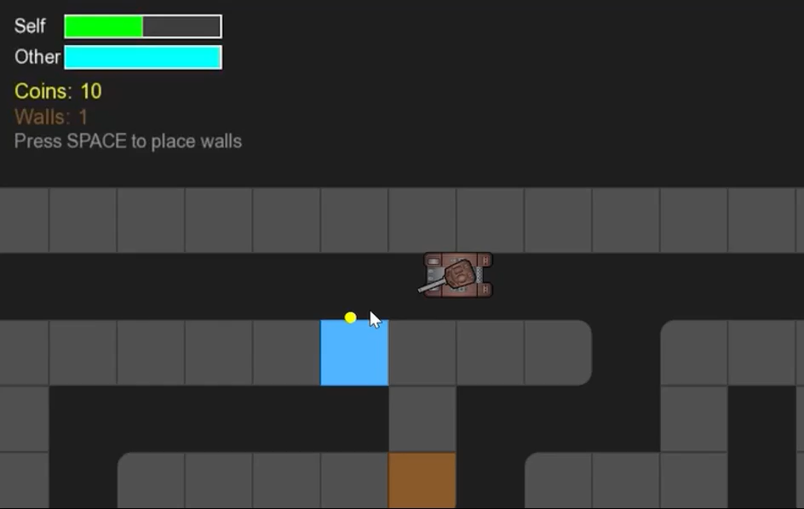
Special Wall Types - Destructible walls with unique effects (repositioning, healing, gold rewards)
Game Modes
Basic Controls
Brown walls: Collect it for future use.
Press Space to place the wall anywhere reasonable you like.
Blue walls: Return 25% of player’s health.
Features
Innovations
Cooperation
Statements

Slide 11
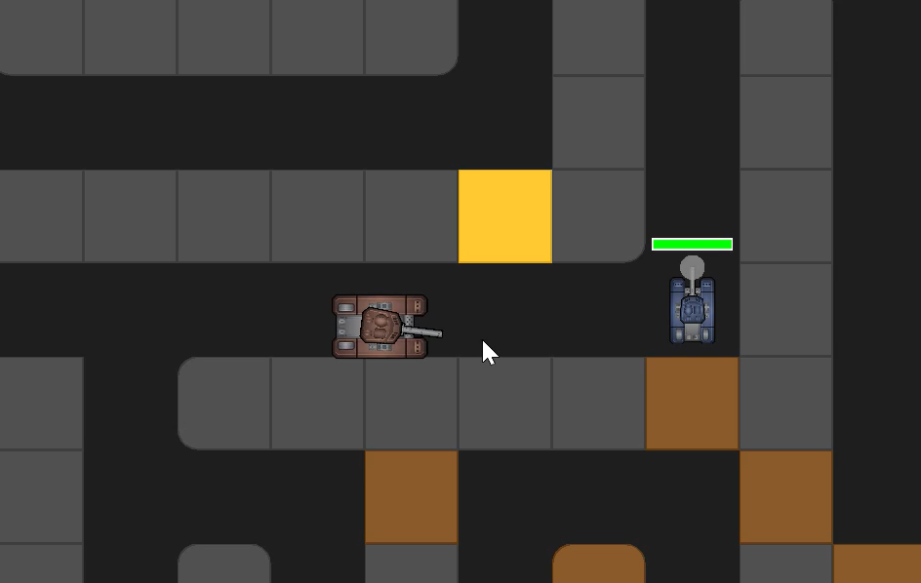
Special Wall Types - Destructible walls with unique effects (repositioning, healing, gold rewards)
Game Modes
Basic Controls
Gold walls: Gain 2 coins.
Press R to ally NPCs with adequate coins.
Blue walls: Return 25% of player’s health.
Features
Innovations
Cooperation
Statements

Slide 12
Game Modes
Cooperation
Basic Controls
Xinyu Jiang: Instruct AI (mainly copilot), Idea, Debug, search for tank images & sound effects, post-processing of images, make PPT
Yang Tian: Instruct AI (mainly copilot), Idea, Debug, search for tank images & sound effects, icon design, post-processing of sound effects, make poster
Features
Innovations
Cooperation
Statements

Slide 13
Game Modes
Future Prospect
Cooperation
Basic Controls
Develop an AI for Single-Player mode that is capable of mimicking a real player’s tank actions.
Xinyu Jiang: Instruct AI (mainly copilot), Idea, Debug, Search for tank images & sound effects, Post-processing of images, Make PPT
Yang Tian: Instruct AI (mainly copilot), Idea, Debug, Search for tank images & sound effects, Icon design, Post-processing of sound effects, Make poster
Features
Innovations
Cooperation
Statements

Slide 14
Resources | Source
Pictures of hulls and weapons | https://craftpix.net/freebies/free-2d-battle-tank-game-assets/?utm_campaign=Website&utm_source=itch.io&utm_medium=public
shoot.mp3 | https://www.epidemicsound.com/sound-effects
chosen.mp3 | https://www.epidemicsound.com/sound-effects
confirm.mp3 | https://588ku.com/ycaudio/50305.html
menu.mp3 | https://www.4399.com/flash/251405_3.htm
Bingo.mp3 | https://www.bilibili.com/video/BV1Cq4y1v7Pz
climax.mp3 | https://www.aigei.com/music/class/painful_aftermath_1?sub=jing_dian_tan_k_5
BulletCollideWithTank.mp3 | https://588ku.com/ycaudio/52019.html
BulletCollideWithWalls.mp3 | https://588ku.com/ycaudio/89448.html
collectCoins.mp3 | https://588ku.com/ycaudio/83587.html
explode.mp3 | https://588ku.com/ycaudio/50822.html
middle.mp3 | https://www.aigei.com/music/class/painful_aftermath_1?sub=jing_dian_tan_k_5
start.mp3 | https://www.aigei.com/music/class/painful_aftermath_1?sub=jing_dian_tan_k_5
wallBroken.mp3 | https://588ku.com/ycaudio/59397.html
Game Modes
Basic Controls
Features
Innovations
Cooperation
Statements

